Slide 1
PREDICTIVE MODEL FOR HOUSE PRICE
By Thi Diem Huong Le
BAN210 – Predictive Analytics
Fall 2022

Slide 2
Objective and workflow
Run 2 models based on Linear Regression algorithm using Forward and Backward method
Help business and individual estimate price range for property
Workflow:
Data cleaning and feature engineering
Exploratory data analysis
Models
Validation

Slide 3
Data cleaning and features engineering
Numeric variables – selected 11 variables with > 50% coefficient
Pearson | Correlation | Coefficient
 | Overall_Qual | Year_Built | Gr_Liv_Area | Garage_Area | Basement_Area | Full_Bathroom | Total_Bathroom | Age_Sold | Overall_Qual2 | Log_Price | Bonus
Sale Price | 0.73 | 0.61 | 0.65 | 0.57 | 0.68 | 0.58 | 0.60 | -0.61 | 0.59 | 0.96 | 0.68

Slide 4
Data cleaning and features engineering
Categorical variables – Dummy Coding – House_Style2
 | Frequency | Percent
1.5Fin | 28 | 9.33
1Story | 198 | 66
2Story | 40 | 13.33
SFoyer | 13 | 4.33
SLvl | 21 | 7
1Story – 1
1.5Fin – 2
2Story – 3
Sfoyer – 4
SLvl – 5

Slide 5
Data cleaning and features engineering
Variables to be dropped
Missing values
Outliers
PID
House_Style
Score
Log_price
Numeric - None
Categorical – use Mode to replace
Use IQR to remove

Slide 6
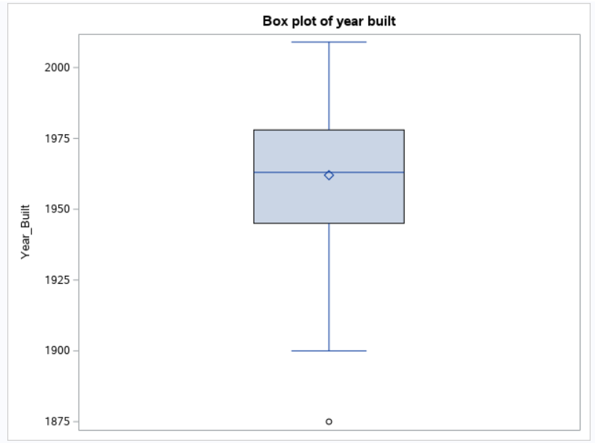
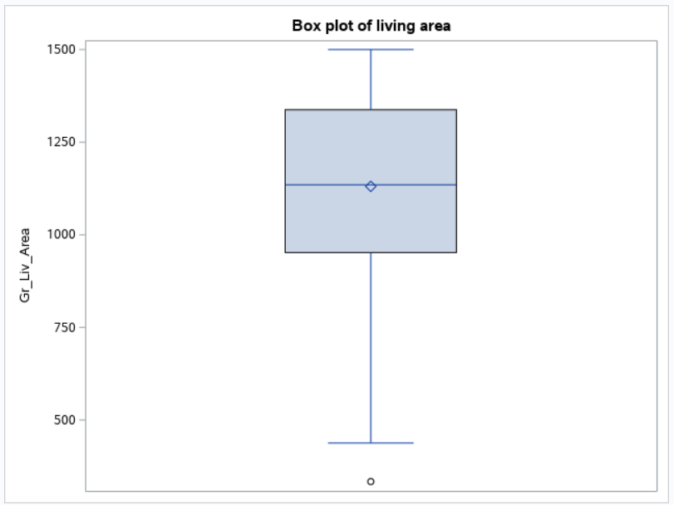

Outliers in graphs
Reduces carbon footprint

Slide 7
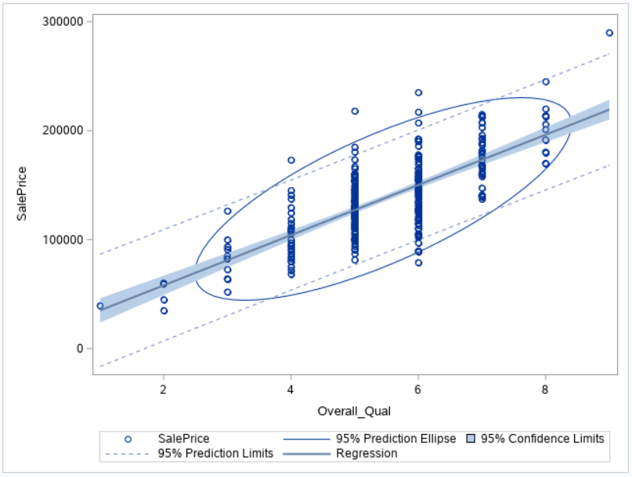
EXLORATORY DATA ANALYSIS
Correlation between Sale Price and Overall_Qual – Positive linear relationship
Coefficient | Overall_Qual
SalePrice | 0.73

Slide 8
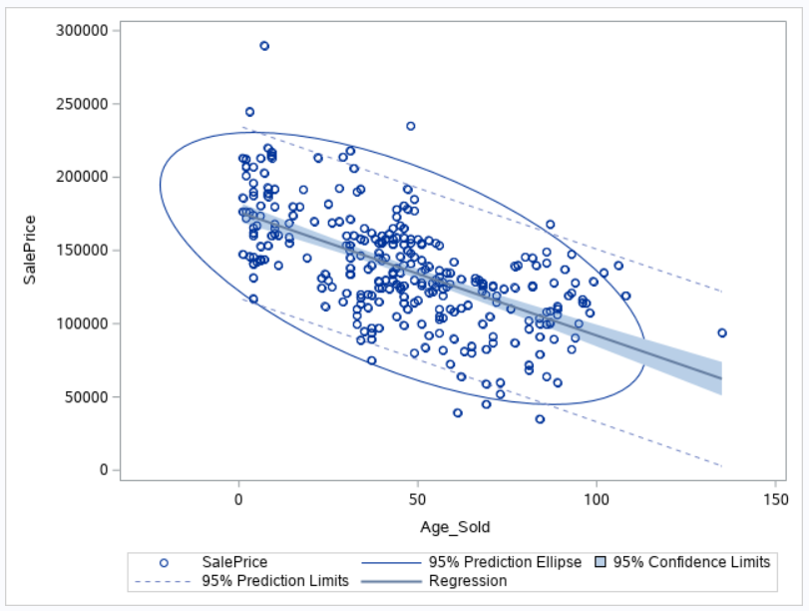
EXLORATORY DATA ANALYSIS
Correlation between Sale Price and Age_Sold – Negative linear relationship
Coefficient | Age_Sold
SalePrice | -0.61

Slide 9
DATA SPLIT
80%
Training
20%
Testing

Slide 10
Model – forward method
Variable | Parameter
Intercept | -414521
Overall_Qual | 7617.38666
Year_Build | 217.06169
Gr_Liv_Area | 48.74540
Garage_Area | 29.01368
Basement_Area | 20.48334
Bonus | 20924
House_Style2_2 | -7226.36988
House_Style2_3 | -3969.20786
House_Style2_5 | 1745.15722
Reduces carbon footprint
The first model is statistically significant with p-value <0.0001 and R-square = 0.8599.

Slide 11
Model – Backward method
Variable | Parameter
Intercept | -389251
Overall_Qual | 7696.35483
Year_Build | 207.81594
Gr_Liv_Area | 49.75345
Garage_Area | 26.98722
Basement_Area | 20.48407
Bonus | 21168
House_Style2_1 | -8380.72288
House_Style2_2 | -11438
House_Style2_3 | -6719.12753
The second model is statistically significant with p-value <0.0001 and R-square = 0.8614
We will use this model as it has higher R-square
Reduces carbon footprint

Slide 12
VALIDATION FRAMEWORK
70% predicted price within plus/minus 10% error compared to actual price
Prediction_Grade | Percent
Grade 1 (within 10% error compared to Actual Price) | 70
Grade 2 (other than Grade 1) | 30

